Slide 1
Azure HPC and Azure Container Service
[ Instructor Name ]
[ Instructor E-mail ]

Slide 2
High-Performance Computing
“High-Performance Computing most generally refers to the practice of aggregating computing power in a way that delivers much higher performance than one could get out of a typical desktop computer or workstation in order to solve large problems in science, engineering, or business.”
--Inside HPC
Notes:
High-performance computing (HPC) typically refers to computing power beyond that of a typical desktop computer. Obviously, the definition of high-performance changes with time as more computing power is crammed into smaller spaces, making the supercomputers of today commodity computers of tomorrow. Regardless though, the concepts of HPC have remained the same since the early days of computing wherein scientists and engineers worked to figure out how aggregate more computing resources to perform computing tasks.

Slide 3
HPC Clusters
HPC typically involves clusters of computers interconnected by a high- speed network
A single computer in the cluster is called a node
Workloads are managed by master nodes that distribute workloads across worker nodes
Notes:
High-performance computing is typically performed on a cluster of computers interconnected by a high-speed network. Workloads are sent to a master node which delegates tasks to the worker nodes. Historically, clusters were built using proprietary, often purpose-built computers. Recent trends though have shifted to using commodity hardware – the same kind of components used to build desktop computers – to construct HPC clusters. Engineers are getting even more clever with how they build clusters, too. The latest trend in HPC has been to use GPUs in addition to CPUs to created HPC clusters. While a typical desktop CPU has 2, 4, or 8 cores, graphics cards have usually hundreds of cores. These cores, while not as powerful as CPU cores, can still perform computations. HPC clusters are combining CPUs and GPUs to squeeze even more performance out of computer hardware for heavy workloads.

Slide 4
HPC in Azure
Run massively parallel compute jobs in the cloud
Photorealistic 3D rendering
Brute force cryptographical analysis
Financial risk modeling, genomics research, and more
Deploy an HPC cluster in minutes and scale as needed
Automate deployments with deployment templates
Combine with Azure Batch for batch scheduling and compute management (http://bit.ly/a4r-batch)
Linux or Windows
Notes:
With Azure, you deploy a cluster of VMs to the cloud in minutes and scale it up and down as needed. They can be Windows VMs or Linux VMs; Azure doesn’t care. In fact, Linux VMs are slightly less expensive because you don’t pay Windows licensing fees for them. You can also choose from a variety of virtual-machine sizes, and you can use deployment templates – something I’ll say more about shortly – to automate your deployments.
Azure Batch can also play a role in HPC by allowing you to schedule jobs to run across a pool of VMs, much like the batch-processing services frequently used on mainframes and supercomputers.

Slide 5
Virtual-Machine Sizes
A-Series
D-Series
F/G/H-Series
N-Series
Up to 8 cores and 56 GB RAM
Also available in DS sizes
Also available in Fs sizes
NVIDIA M60 x 1/2/4
A0
A1
A2
A3
D1
D2
D3
D4
F1
F2
F4
F8
NV6
NV12
NV24
A4
A5
A6
A7
D11
D12
D13
D14
F16
NVIDIA K80 x 1/2/4
Compute-intensive
Also available in DS sizes
Also available in GS sizes
NC6
NC12
NC24
A8
A9
A10
A11
D1v2
D2v2
D3v2
D4v2
G1
G2
G3
G4
D11v2
D12v2
D13v2
D14v2
G5
20 cores, 140 GB Ram
Molecular modeling etc.
D15v2
DS15v2
H8
H16
H8m
H16m
H16r
H16mr
* Currently in preview
Notes:
Azure offers a variety of VM sizes in an effort to make sure there’s something to fit everyone’s needs. Each size is identified by a letter and a number: A0, D1, G2, and so on. There is documentation online detailing the specs for each machine – number of cores, amount of RAM, type and size of hard disk, for example – as well as the cost. Not surprisingly, more powerful machines are most costly as well. Prices range from as little as 7 cents an hour for a single core machine running Linux to almost $10 an hour for a machine with 32 cores and almost half a terabyte of RAM. The G-series machines are reserved for the most power-hungry applications.
Costs can grow astronomically when you talk about clusters with hundreds or even thousands of cores. But cost isn’t really the point. The point is having massive amounts of computing power at your fingertips. Besides, the cost of “renting” even the largest virtual cluster pales in comparison to the cost of purchasing, setting up, and maintaining a similarly sized cluster of your own.
Not all VM sizes are available in all data centers. For the latest pricing information and availability, see https://azure.microsoft.com/en-us/pricing/details/virtual-machines.
N-series VMs are currently in preview and are an answer to researchers who need GPU power to perform complex calculations. They are equipped with NVIDIA Tesla GPUs.

Slide 6
Choosing a VM Size
CPU core = Memory
A0 - A7
D1v2 - D5v2
D1 - D4
CPU core > Memory
F1, F2, F4, F8, F16
CPU core < Memory
D11v2 - D15v2
D11 - D14
G
GPU
N
CPU core++
A8 - A11
G(S)5
D(S)15v2
Memory++
G(S)4, G(S)5
D(s)15v2
Networking++
A10 - A11
Notes:
For background, see https://blogs.msdn.microsoft.com/uk_faculty_connection/2016/09/12/choosing-the-most-appropiate-azure-virtual-machine-specification/?wt.mc_id=DX_873849. Not shown here are H machines, which are optimized for extremely heavy computing workloads.

Slide 7


Power vs. Cost
A8
D1
G5
8 cores
56 GB RAM
382 GB SSD drives
32 Gbit/sec InfiniBand RDMA
1 core
3.5 GB RAM
50 GB SSD drives
32 cores
448 GB RAM
6,144 GB SSD drives
Latest Xeon E5 v3 processors
$ 1.47/hr. or $1,091/mo.
$0.14/hr. or $104/mo.
$ 9.65/hr. or $7,180/mo.
$0.98/hr. or $725/mo.
$0.077/hr. or $57/mo.
$ 8.69/hr. or $6,465/mo.
See bit.ly/a4r-vm-pricing for up-to-date pricing information
Notes:
Here’s a quick look at three of the Azure VM sizes so you can see how they differ in cost and capability. One thing to keep in mind when deploying VMs is that you get charged for them whether they’re in use or not. When you’re finished using a VM or a cluster of VMs, it behooves you to go into the Azure portal and suspend each VM to avoid unnecessary charges. Once suspended, a VM is easily restarted so you can pick up where you left off and continue using it. I’ll show you how to start and stop VMs in the demo coming up shortly. I’ll also show you how to delete them so you can avoid even incurring storage charges for VMs that are no longer needed.

Slide 8
Azure Resource Manager
Allows resources to be collated into resource groups
Deploy, manage, monitor, and delete all resources at once rather than one resource at a time
Allows complex deployments to be performed declaratively via deployment templates
Deployment templates specify all the resources — VMs, switches, storage accounts, etc. — to be provisioned using JSON syntax
Templates can include parameters that are filled in at runtime
Learn more at http://bit.ly/a4r-arm
Notes:
An important element of HPC in Azure is the Azure Resource Manager. The Azure Resource Manager is a relatively recent addition to Azure. It lets you combine the resources that comprise an application – resources such as VMs, databases, virtual networks, and storage accounts – into resource groups so entire applications can be deployed, managed, and even deleted with a single step. Prior to Resource Manager, resources had to be created (and deleted) one by one, which quickly became onerous with large deployments.
The Azure Resource Manager allows you to deploy applications using declarative templates called deployment templates. A template contains a complete description of all the resources that make up the application. Templates can include parameters that users will be prompted to fill in each time an application is deployed. Templates can also run scripts to initialize resources to a known and consistent state.
As an example, suppose you have built an HPC cluster that includes virtual machines and other Azure resources. With a template, you can script the creation of the entire cluster and optionally the data that goes with it. This makes it easy for others to spin up instances of the cluster, or for you to recreate it if you deleted it thinking you wouldn’t be needing it again.

Slide 9
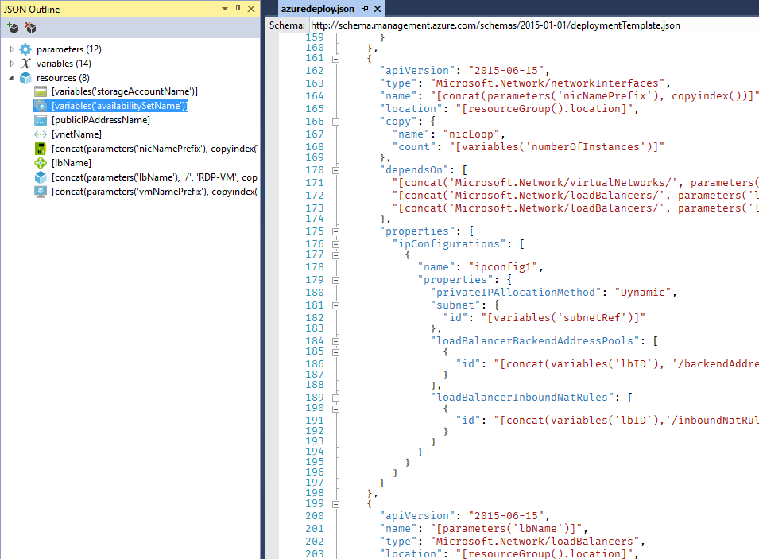
ARM Templates
Declarative deployment
Maintain resources with the same lifecycle within a resource group
Configure parameters for input/output
Specify resources & dependencies
Leverage Quickstart Templates or export existing resources
Notes:
Notes:
Another deployment option is to use ARM Templates
ARM Templates are declarative files that define the resources to deploy and the inter-relationships between deployed resources
Specify input parameters and variables, use expressions
Use Azure Quickstart templates, with source in GitHub
Edit in Azure online editor, use Visual Studio tooling, use Visual Studio Code
They can be checked into source control in order to simplify deployment management

Slide 10
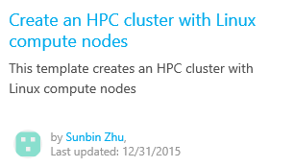
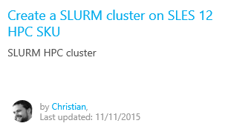
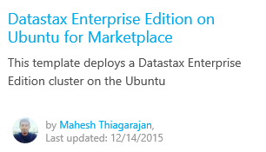
Azure Quickstart Templates
Free, open-source deployment templates
Find them on the Azure site (http://bit.ly/a4r-quickstart)
Or browse them on GitHub (http://bit.ly/a4r-github)
Notes:
You can build deployment templates of your own, or you can use ones that have already been built. An assortment of templates built by the Azure team and by others in the community can be found on the Azure Quickstart Templates Web site or on GitHub. There are templates for creating clusters of Linux VMs, deploying Redis clusters of Ubuntu VMs, deploying MySQL servers, creating Windows VMs provisioned with IIS, and a whole lot more. There is even a template that deploys Minecraft Server in an Ubuntu VM.
Using any of these templates requires nothing more than a button click. Each template comes with documentation that tells you what parameters it requires and whether the template was created by Microsoft or by someone in the community. Best of all, you can view each template’s source code, which is little more than a JSON script, and customize it to fit your needs or even build upon it to create templates of your own.
The three templates pictured here are just a few of the many dozens of templates currently available.

Slide 11
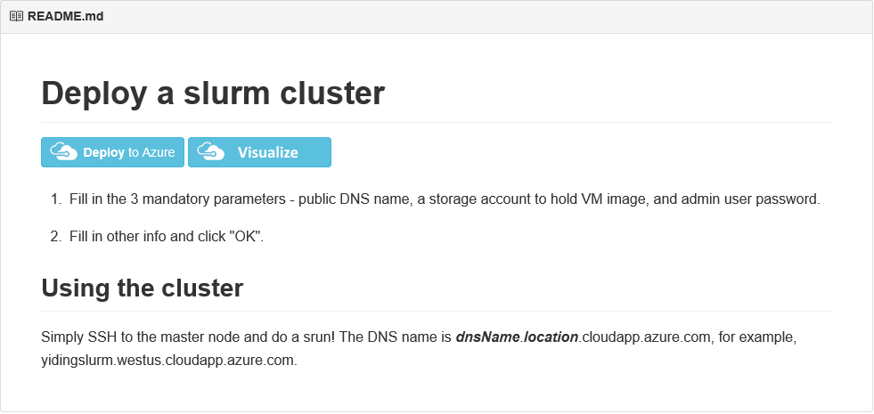
SLURM Clusters
Simple Linux Utility for Resource Management (SLURM)
Quickstart template at http://bit.ly/a4r-slurm enables easy deployment of SLURM clusters of user-specified sizes
Notes:
The Simple Linux Utility for Resource Management (SLURM), also known as the SLURM Workload Manager, is a free and open-source job scheduler for Linux that excels at distributing heavy computing workloads across clusters of machines and processors. It is used on more than half of the world's largest supercomputers and High-Performance Computing (HPC) clusters, and it enjoys widespread use in the research community for jobs that require significant CPU resources.

Slide 12
Containers
Lightweight alternative to virtual machines
Smaller, less expensive, faster to start up, and self-contained
Virtual Machines
App
App
App
Libraries
Libraries
Libraries
Containers
Guest OS
Guest OS
Guest OS
App
App
App
Libraries
Libraries
Libraries
Hypervisor
Container Engine
Host Operating System
Operating System
Notes:
A virtual machine is -- well -- a virtualized machine created and managed by a hypervisor such as VirtualBox or Hyper-V. Even though a VM runs on a machine that has an operating system, each VM requires its own complete operating system, even if it's the same operating system as the host OS. VMs offer a very high degree of isolation, but at a cost: longer startup times, lower portability (ever tried to move a 127 GB virtual hard disk, or VHD, from one PC to another?), and higher memory requirements. Containers, by contrast, leverage the operating system that is already in place but offer nearly as much separation. RAM requirements are lower since the OS isn't being duplicated in each container, and cost is lower, too, because while cloud platforms typically charge for each VM, a single VM can host multiple container instances.

Slide 13
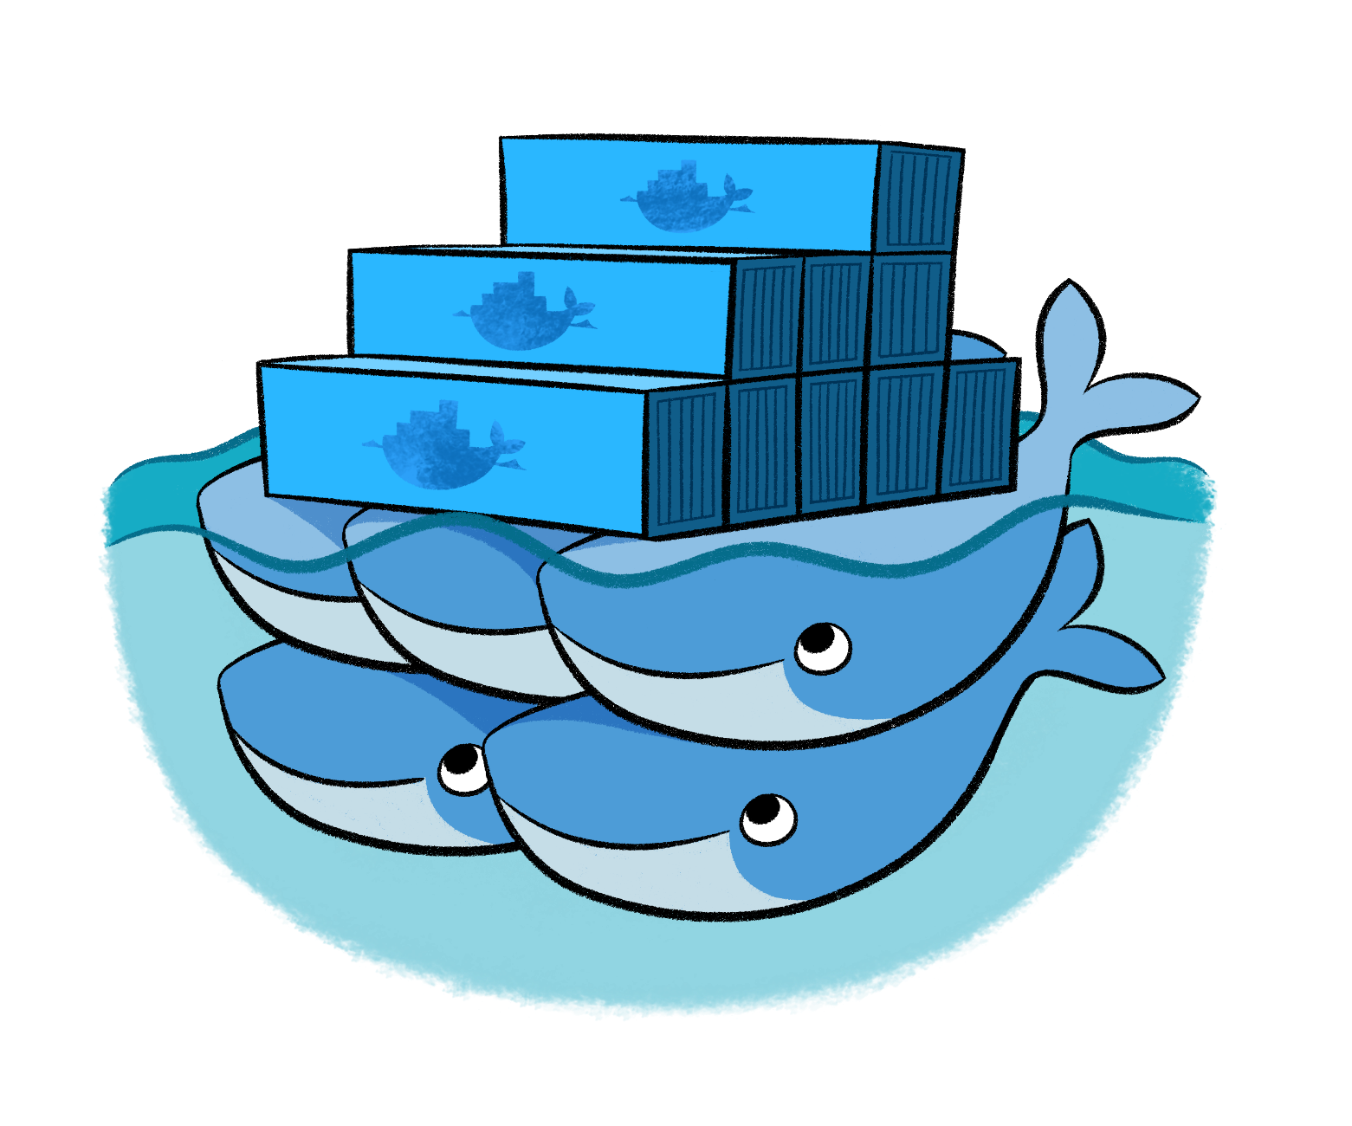
Docker
Leading open-source containerization platform
Supported natively in Azure
Docker containers wrap up a piece of software in a complete filesystem that contains everything it needs to run: code, runtime, system tools, system libraries – anything you can install on a server. This guarantees that it will always run the same, regardless of the environment it is running in
Notes:
Docker (www.docker.com) isn't the world's only containerization platform, but it is the most popular. It is free, open-source, and Linux-based, with Windows support (Windows Server 2016) in the works. It has earned massive mindshare in the developer community. And with Azure Container Service, you can deploy Docker containers to Azure with minimal effort. Moreover, Docker containers are easily moved between Azure and Amazon Web Services (AWS), affording developers portability between cloud platforms.

Slide 14
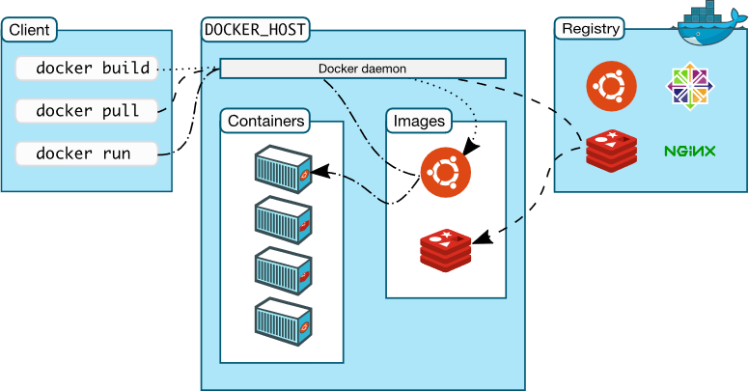
Docker Architecture
Notes:
Docker utilizes a client-server architecture. You execute Docker commands through a Docker client such as the Docker CLI or Kitematic. The client uses REST commands to communicate with the Docker daemon running on a Docker host such as the Azure Container services. These commands can be used to push, pull (docker pull), and create Docker images, to run them in containers, and to manage those containers. Images can be built with the docker build command, and they can be stand-alone, or they can "inherit" from other images. Images are stored in Docker registries, which can be public or private, local or remote. Docker Hub is a popular public registry that is managed by Docker; it contains a "huge collection" of images that anyone may use. The docker run command runs a container using an image as a template.

Slide 15
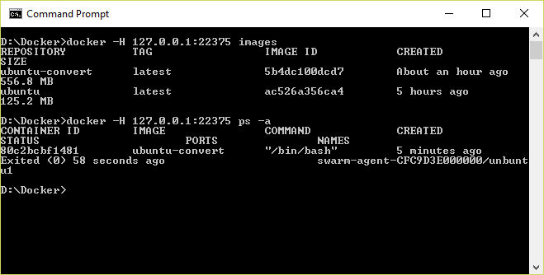
Docker CLI
Command-line interface for Docker, available for Linux, OS X, and Windows (available separately or as part of Docker Toolbox)
Notes:
The Docker Client, also known as the Docker CLI, is the primary tool you use to manage Docker containers. You can download container images from repositories such as Docker Hub, build container images, run container instances, list container images and instances, and much more. After connecting to Azure Container Service using SSH, you can use port forwarding to execute commands locally that act on an Azure Container Service running in the cloud. In this example, the -H switch used with the docker commands forwards commands sent to port 22375 on localhost to the Azure Container Services via SSH.

Slide 16
Running a Container
docker run -i -t ubuntu /bin/bash
Docker CLI command
Run container with interactive terminal
Pull "ubuntu" image from Docker Hub or local registry
Command to execute in the container
Notes:
This command pulls the image named "Ubuntu" from Docker Hub (or a local registry if the image is cached there) and runs it interactively in a container. "Interactively" means standard input, output, and error are connected locally so you can provide input to the container and see its output. Of course, you are not limited to the "Ubuntu" image. You can specify other images and even create images of your own with docker build. Where the container runs depends on the context. The container can run locally in a docker host (for example, a VM on Windows), or it can remotely if you connect to a remote Docker daemon (for example, one running in Azure) via SSH tunneling and use port forwarding to forward docker commands to the daemon.

Slide 17
Common Docker CLI Commands
docker run - Use an image to run a container
docker pull - Pull an image from a registry
docker build - Build a Docker image
docker images - List available Docker images
docker ps - List running Docker containers
docker exec - Execute a command in a container
docker stop - Stop a running container
Notes:
These are some of the most commonly used docker commands. You can also use docker push to push an image to a registry such as Docker Hub. Also, docker ps is often accompanied by a -a switch to list all containers, including those that are no longer running, while docker rm and docker rmi are used to delete (remove) containers and images, respectively. The docker build command uses a Dockerfile (a text file containing build commands) and a "context" -- for example, a specified directory in the file system -- to build Docker images.

Slide 18
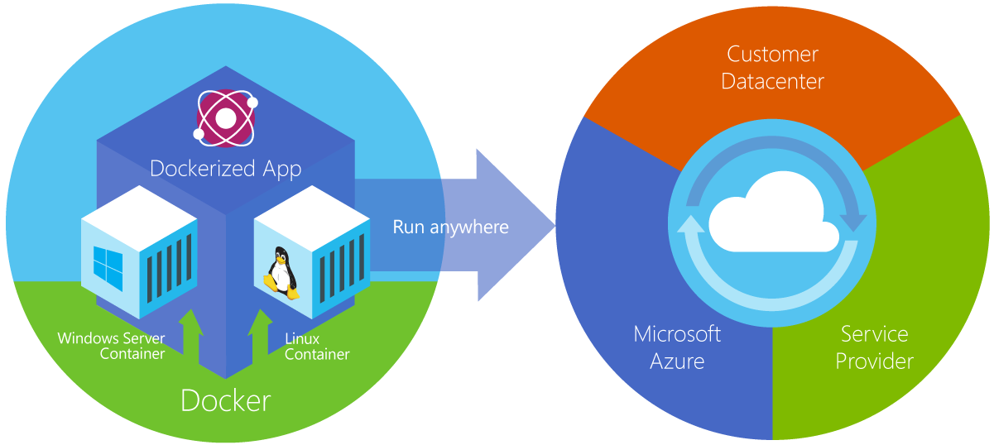
Azure Container Service
Provides robust, ready-to-use Docker hosting environment
Uses open-source orchestration tools (DC/OS and Swarm)
Notes:
From the documentation: "Azure Container Service makes it simpler for you to create, configure, and manage a cluster of virtual machines that are preconfigured to run containerized applications. It uses an optimized configuration of popular open-source scheduling and orchestration tools. This enables you to use your existing skills, or draw upon a large and growing body of community expertise, to deploy and manage container-based applications on Microsoft Azure." ACS supports Linux containers and Windows containers. The latter rely on Windows Server 2016.

Slide 19
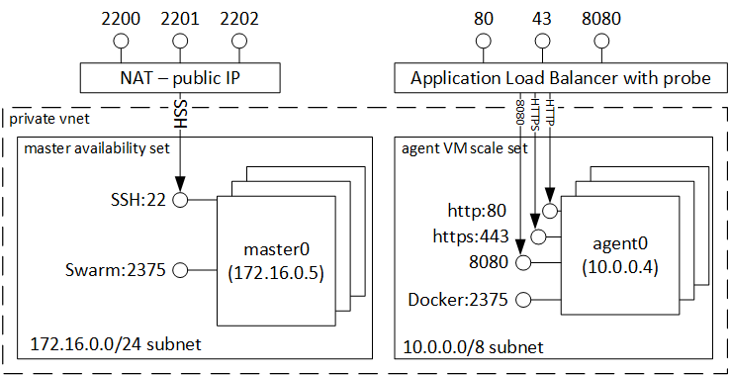
Clustering with Docker Swarm
Notes:
Here's what happens in Azure when you create an Azure Container Service with Docker Swarm as the orchestrator. Azure creates one or more master VMs to control the "swarm" of containers, as well as a Virtual Machine Scale Set, which provides the "agent" VMs in which containers run. All these VMs communicate over a private virtual network. To communicate with Docker Swarm in a master VM from a Docker client running on a local machine, you establish an SSH tunnel that forwards the local port 22375 to port 2375 in the VM (via SSH port 2200). This allows you to execute local commands that load container images and run containers in the cloud. Docker Swarm manages the container instances in the agent VMs as well as the agent VMs themselves. You don't have to know this to use Azure Container Service, but it does help explain various port forwarding commands that you employ when running the Docker client on a local machine connected to Azure.

Slide 20
Connecting to Docker Swarm in ACS
Establish SSH tunnel to master load balancer
Use port forwarding to forward local Docker commands to Docker daemon on master LB
ssh username@dnsname -p 2200 -L 22375:127.0.0.1:2375
Establish SSH connection via port 2200 (default is 22)
Forward commands transmitted through port 22375 by the Docker CLI to port 2375 on the other end
Notes:
This command works in a terminal window on OS X or Linux. (Windows users need to use a third-party SSH tool such as PuTTY.) The purpose of the -L switch is to forward traffic transmitted through port 22375 on the local machine (that's the port used by the Docker CLI) to port 2375 at the other end. Docker Swarm listens on port 2375. The -p switch instructs SSH to use port 2200 rather than the default 22. The load balancer you're connecting to listens on port 2200 and forwards the SSH messages it receives to port 22 on the master VM.

Slide 21
Hands-On Lab
SLURM Linux Cluster HOL.html
Docker and Azure Container Service HOL.html

